Slide 1
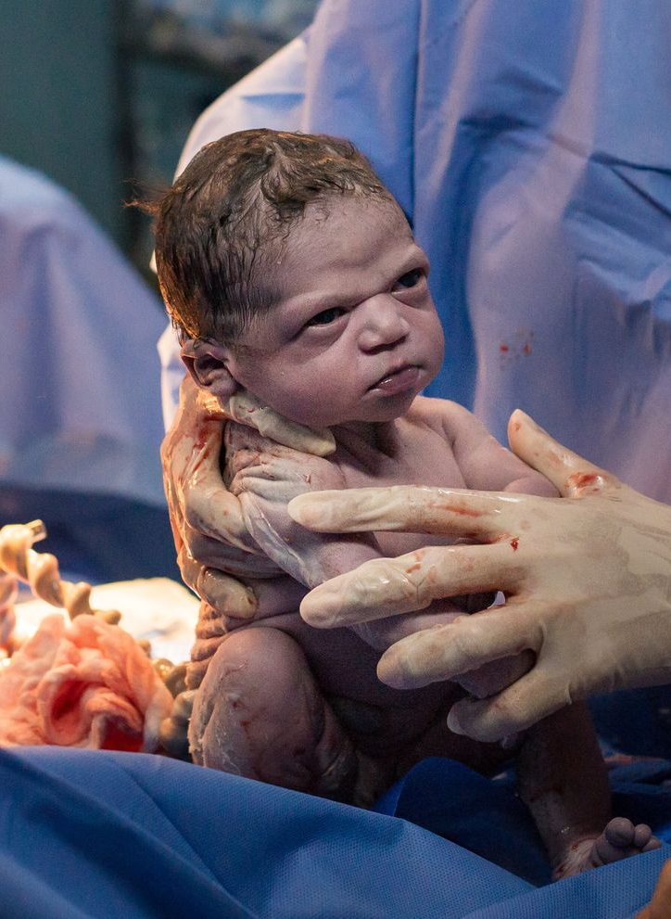
Stages of labour
AEHBY Human Biology

Slide 2
Review
Identify the hormone that acts on the corpus luteum to maintain the early stages of pregnancy. State the source of this hormone in early and mid-late pregnancy. (3)
Briefly explain the difference between the germ (pre-embyronic), embryonic and foetal stages of pregnancy. (6)
Sketch a heart, showing all the chambers and blood vessels (8)

Slide 3
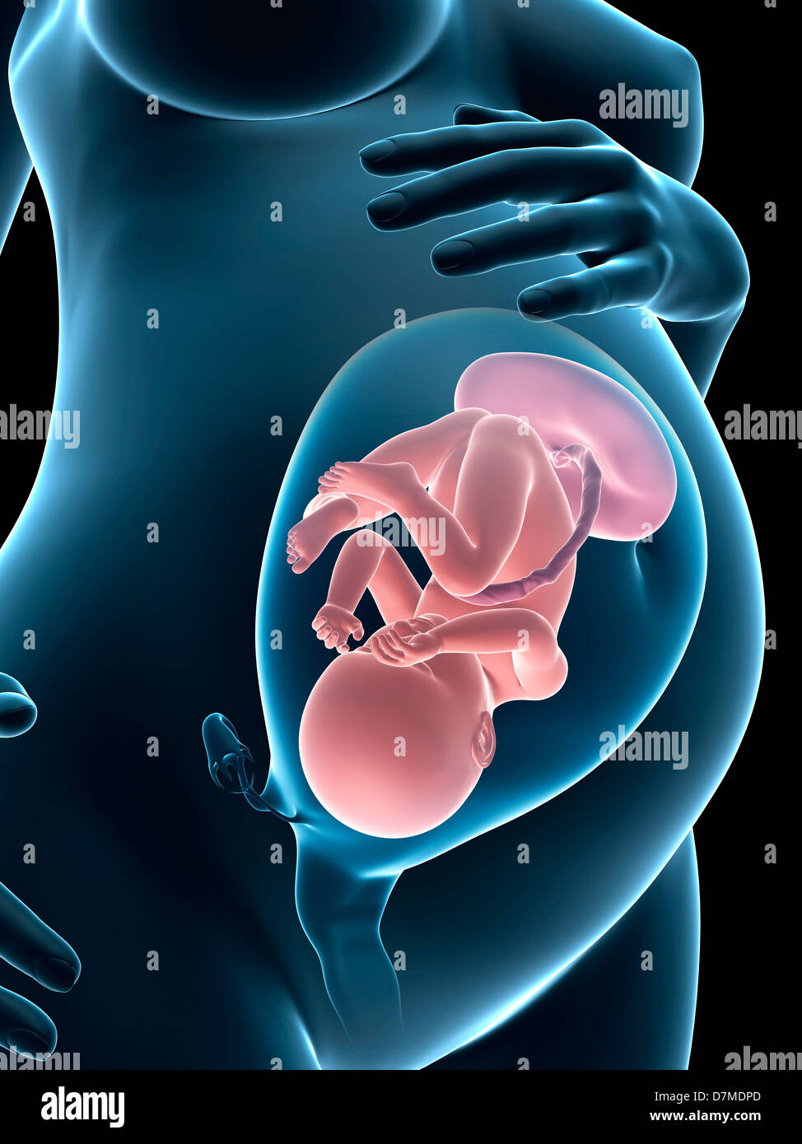
Learning Intentions
The stages of labour include birth, during which there are circulatory system changes in the child.

Slide 4
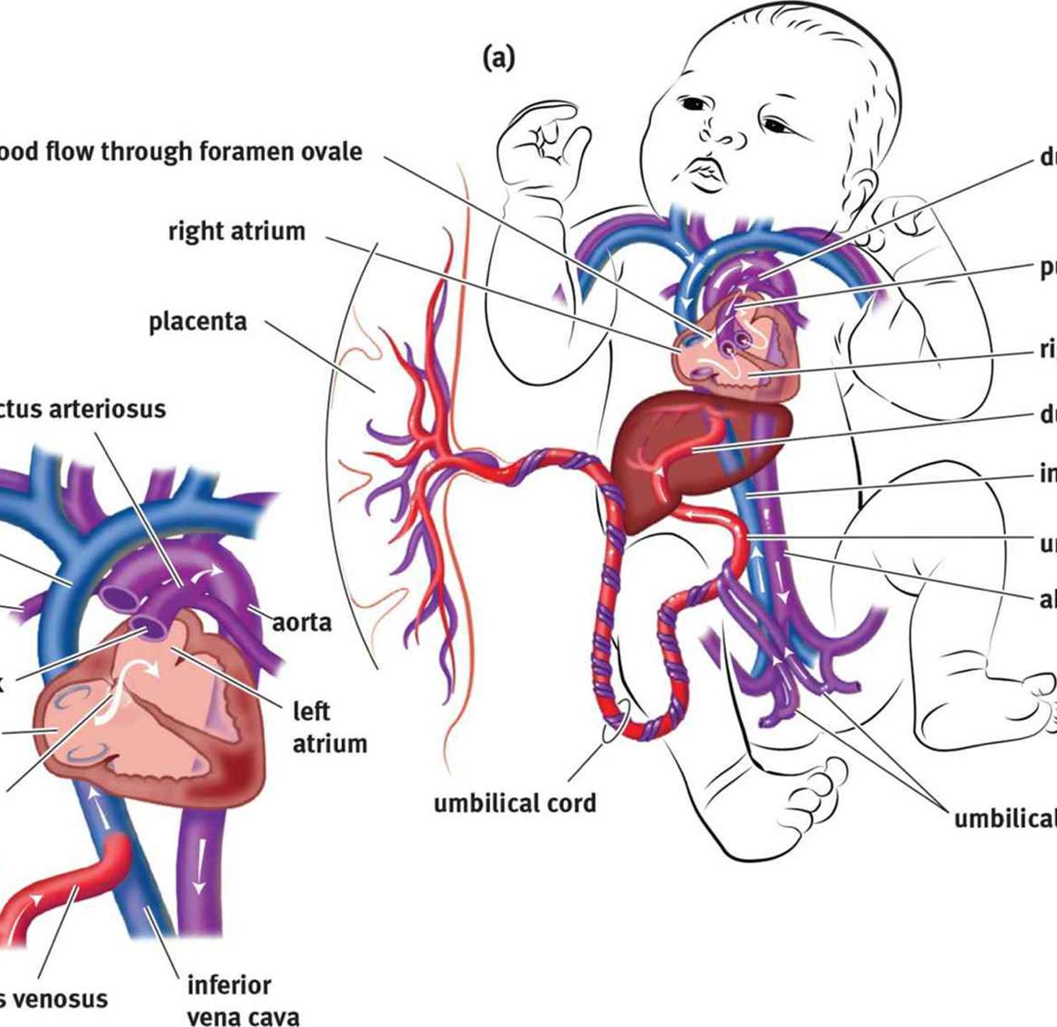
Success criteria
Define parturition.
Describe the three stages of labour.
Describe the key changes in foetal circulation at birth.

Slide 5
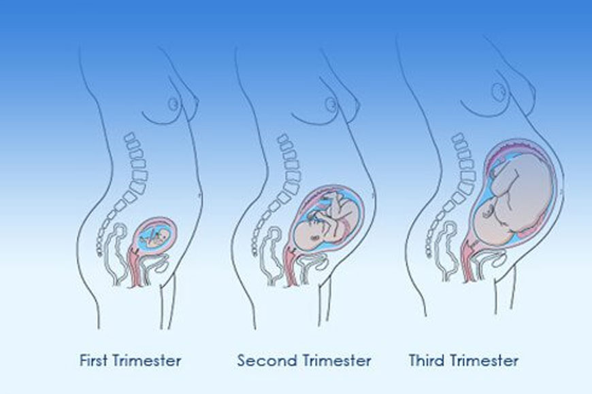
Birth
Parturition is the process by which the foetus is expelled from the mother’s body at the end of gestation. {commonly called labour}

Slide 6
First stage
During the third trimester, the muscles of the uterus undergo irregular contractions which become more frequent towards the end of the pregnancy.
As these contractions become stronger, more regular and frequent (30 minutes apart) labour begins.
Contractions push the foetus against the cervix, causing it to shorten and then dilate.

Slide 7
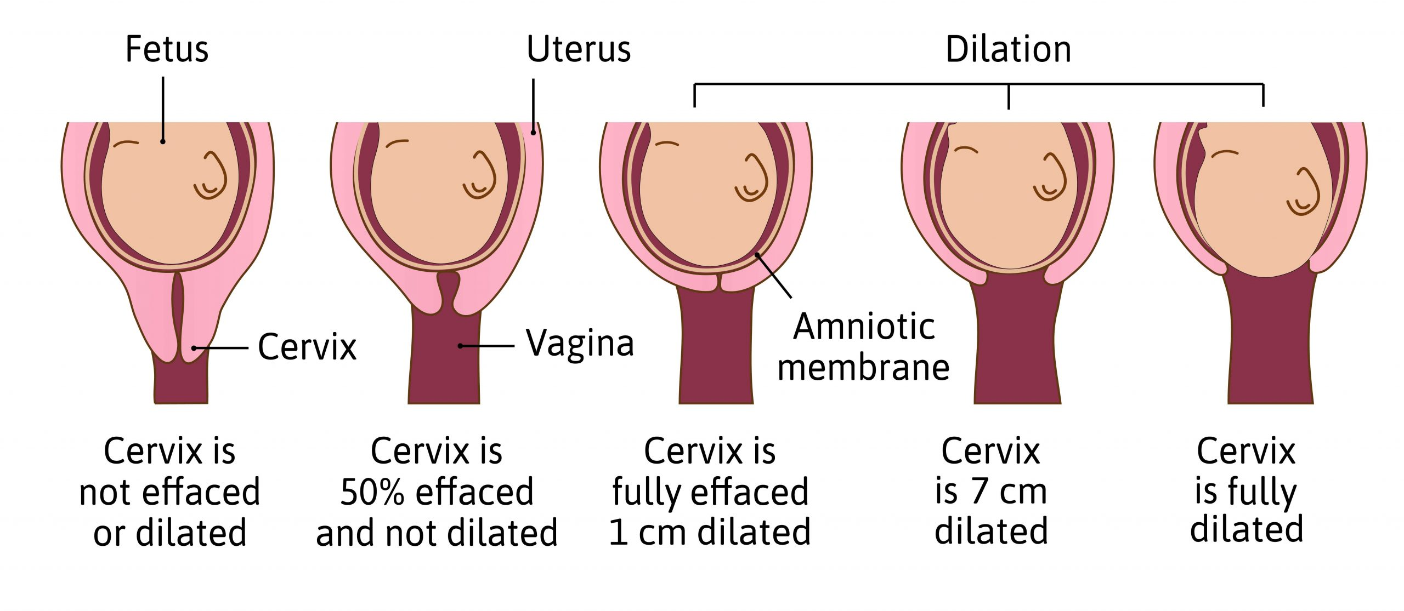

Slide 8
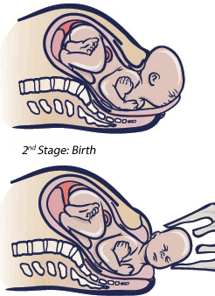
Second stage
The foetus moves through the birth canal (vagina).
The amniotic membranes often rupture during this stage (although can occur earlier).
Usually lasts from 20 minutes to 2 hours).

Slide 9
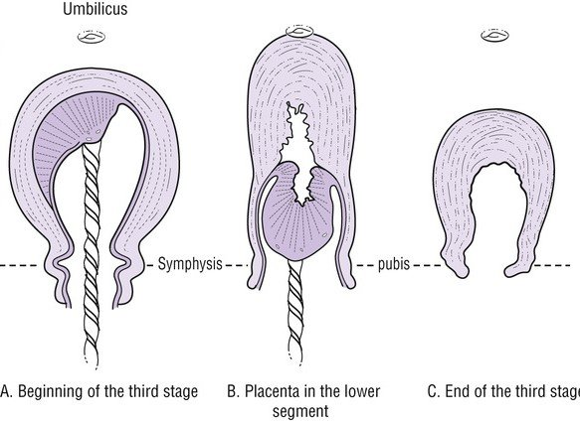
Third stage
Contractions constrict the blood supply to the placenta. The uterus continues to contract to expel the amnion, chorion and placenta, with the remains of the umbilical cord.

Slide 10
Foetal circulation
Before birth, lungs do not function - all oxygen is supplied via the umbilical cord from the placenta and nutrient levels are maintained by the maternal blood supply and the mother’s liver. Much of the incoming blood supply bypasses the liver, and travels directly to the vena cava through the ductus venosus.

Slide 11
Blood bypasses the non-functioning lungs, flowing directly from the pulmonary artery to the aorta through the ductus arteriosis.
An oval opening between the right atrium and the left atrium, called the foramen ovale, allows blood to flow between the atria.

Slide 12
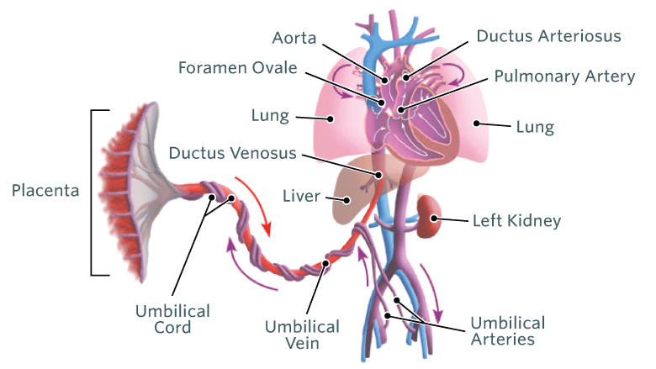

Slide 13
Changes to foetal circulation
With the first breath (prompted by increasing CO2 levels), the lungs inflate and begin to function.
The expanding lungs reduce blood flow through the ductus arteriosis, which gradually shrivels within a week or so after birth.

Slide 14
Blood returning from the lungs increase atrial pressure, forcing the foramen ovale to close and eventually grow over.
Reduced blood flow through the umbilical cord restricts blood flow through the ductus venosus, this bypass around the liver is lost.

Slide 15
Success criteria
Define parturition.
Describe the three stages of labour.
Describe the key changes in foetal circulation at birth.

